Slide 1
Introduction to Business Presentations
As part of Week 6, Unit 6
CC11 Communication in the Workplace

Slide 2
Table of Contents
Introduction to oral presentations
Creating visual and multimedia presentations
Tips on creating a business presentations
Best practices on oral presentations

Slide 3
Introduction to Oral Presentations
Oral presentations in the workplace | Types of oral presentations | Purposes of oral presentations | Factors in constructing oral presentations

Slide 4
Oral Presentations in the Workplace
Presentation of ideas to members in the organization:
General organizational practices
Progress of projects
Introduction to new concepts
Re-echoing
Mostly used to show off the work being done
Used as a measure to see the employee’s contributions to the company

Slide 5
Types of Oral Presentations
Manuscript
Speech is written and reads it word-for-word
Used in company-wide presentations with a short runtime
More common to be used by upper management
Memorized
Manuscript is committed to memory and recited
Not common in business settings
Can be used for presentations where an employee is representing a company

Slide 6
Types of Oral Presentations
Impromptu
Speeches entirely made up on the spot
Mostly unprepared or unrehearsed
Examples: grace before meals, acknowledgement, introduction
Extemporaneous
In-between the memorized and impromptu
Speeches are not completely written out
Keynotes are included for reference
Most common for business oral presentations

Slide 7
Purposes of Oral Presentations
Information sharing
Organization rules and business practices
Progress reports
Presentation of new information
Instructional
New / modified business practices
Persuasive
Decision-making
Mostly used for aiding

Slide 8
Factors in Constructing Oral Presentations
Preparation
Nature of the oral presentation
Content of the oral presentation
Time allotted for preparation
Presentation aid
Presentation Proper
Time allotted for presentation
Number of participants
Types of participants (rank, prior knowledge, etc.)

Slide 9
Creating Visual and Multimedia Presentations
What is a presentation aid? | Types of presentation aids | Examples of presentation aids | What is a multimedia presentation? | Tools for multimedia presentations

Slide 10
What is a Presentation Aid?
Also known as sensory aids
Set of resources used to enhance the message conveyed by the speaker
Resources beyond the speech itself
Usually visual in presentation:
Images / pictures
Videos
Diagrams, charts, and graphs
Maps

Slide 11
What is a Presentation Aid?
Meant to be an aid
Ideas presented should be aligned with the presentation
Should not eclipse the presentation
Usually short / does not contain a lot of content
Must be easy to use

Slide 12
Types of Presentation Aids
Computer-based media
Audiovisual media
Low-tech media
Chalk or dry-erase board
Flipchart
Poster board / foam board
Handouts

Slide 13
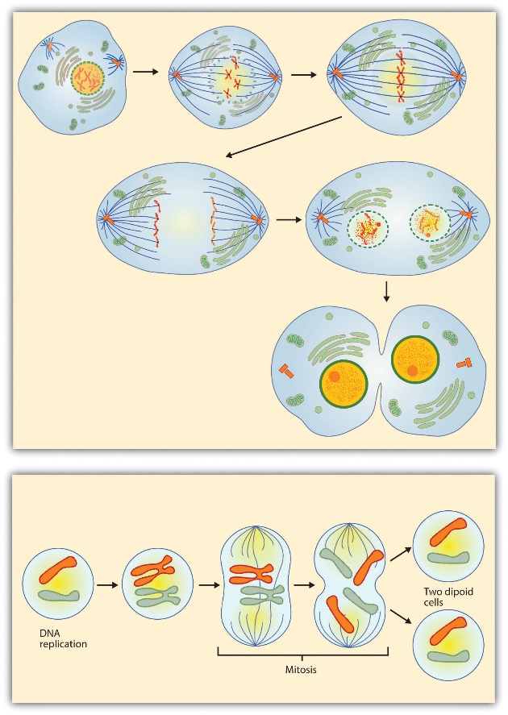
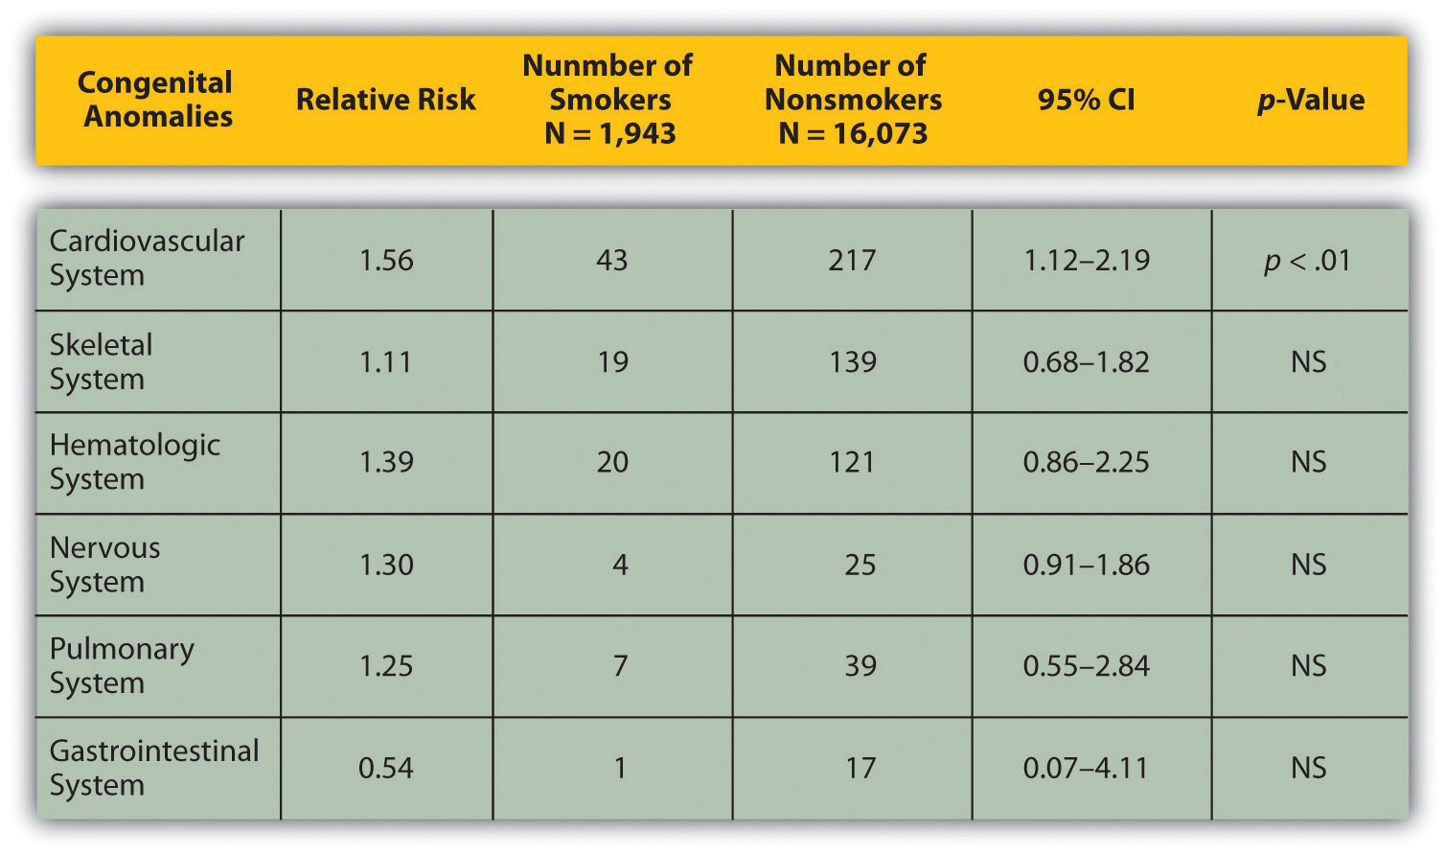
Examples of Presentation Aids
Statistical Tables
Sequence of Step Charts

Slide 14
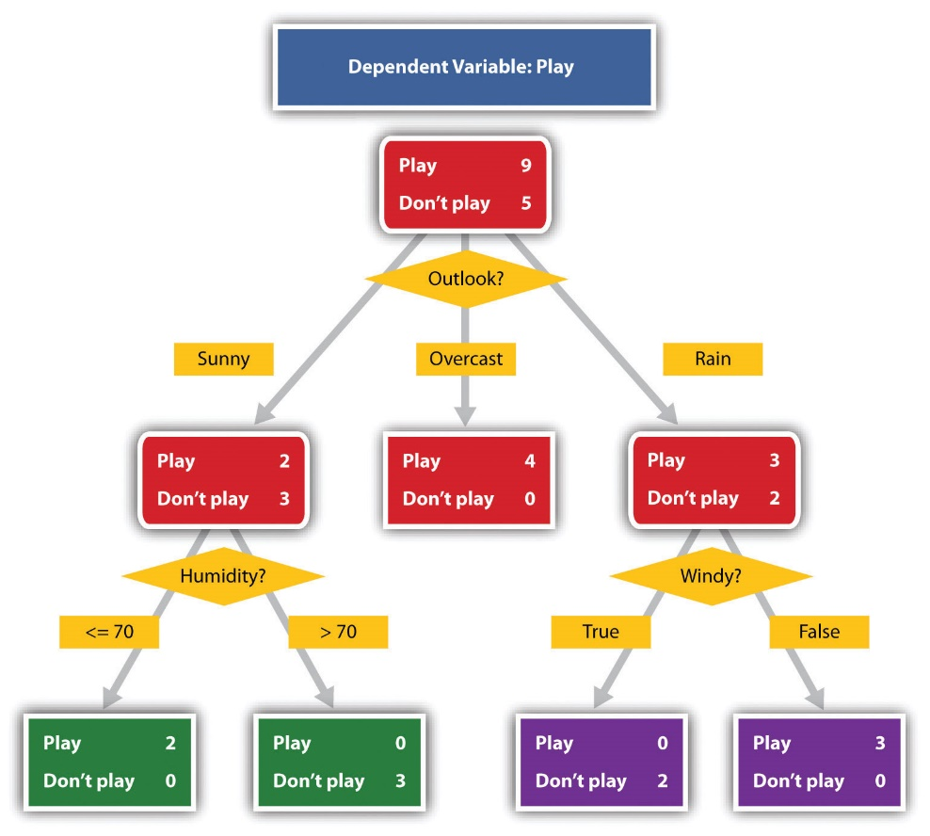
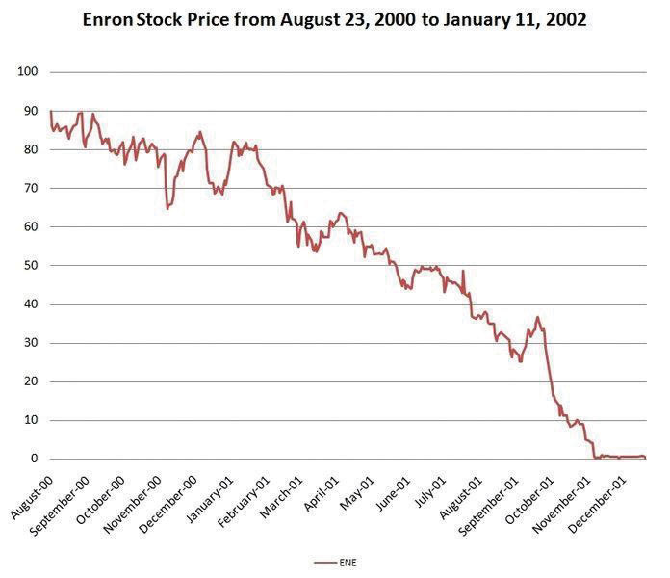
Examples of Presentation Aids
Decision Trees
Graphs

Slide 15
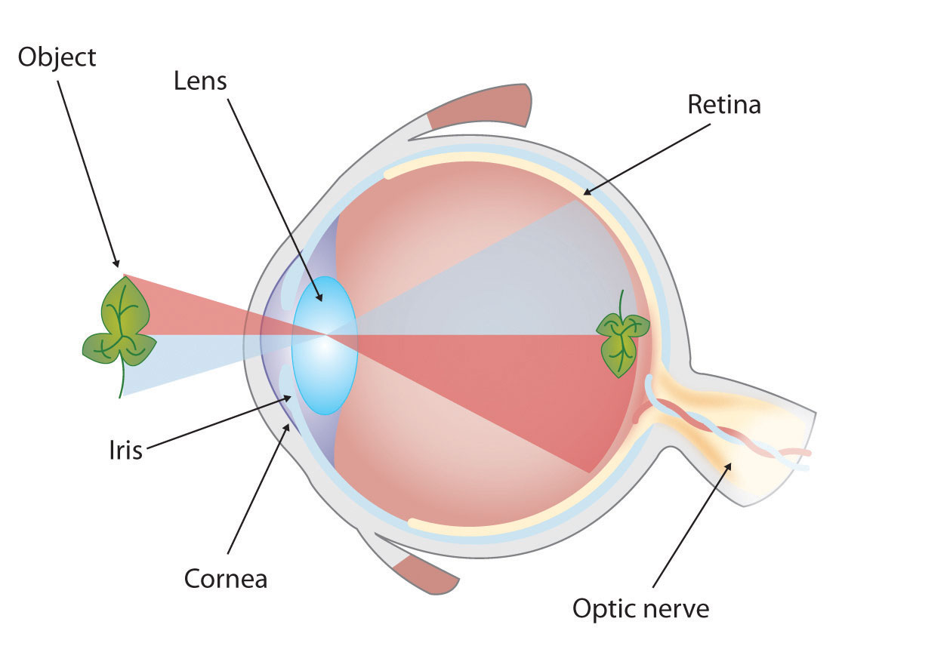

Examples of Presentation Aids
Diagrams
Maps

Slide 16

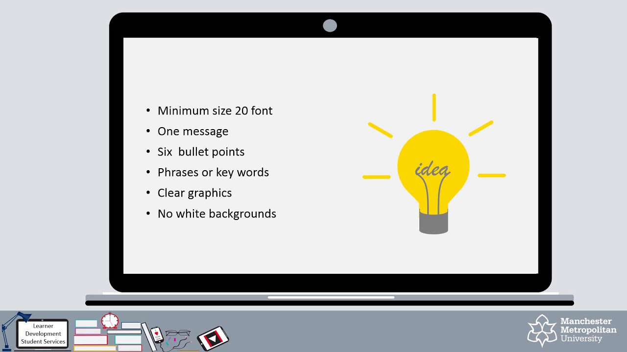
Examples of Presentation Aids
Photographs / Drawings
Keywords

Slide 17
What is a Multimedia Presentation?
Type of presentation that uses different forms of communication to get the message across
Speakers in professional contexts are expected to be familiar with common multimedia presentation tools
Includes:
Text and images
Animation
Video
Audio
Interactive features (forms, popups)

Slide 18
Tools for Multimedia Presentations
Presentation software
Microsoft PowerPoint
Google Slides
Canva
Prezi
Interactive applications
Quizlet
Kahoot
Mentimeter

Slide 19
Tips in Creating Business Presentations
Steps in constructing a business presentation | Tips in creating business presentations

Slide 20
Steps in Constructing a Business Presentation
Define the purpose of the multimedia presentation
Outline content with visualization ideas
Select a presentation template to add content
Add multimedia content
Review, download, and share

Slide 21
Tips in Creating Business Presentations
Multimedia presentation tool
Content, photos, and illustrations
Font
Color palette
Animations and transitions
Graphic design
Presentation templates
Editing out

Slide 22
Multimedia Presentation Tool
Choose the most appropriate presentation tool according to the nature of the presentation
Content placed in presentation (text only, inclusion of images and videos)
Hardware requirements, software compatibility, and network capabilities
Level of interaction with audiences
File format (.pptx / .ppt / .pdf)

Slide 23
Content, Photos, and Illustrations
Divide content by slides
Limit the content to be placed in the presentation
One should not be reading out of a presentation
Points that are placed are the most relevant ones
7 x 7 rule
Place as bullet points for easier readability
Include photos and illustrations when necessary
Some would include images that are just for decoration
Image must visualize an idea
Company logos are acceptable

Slide 24
Font
Bigger font sizes
Title and headers: around 48
Content: at least 18; around 24
Font style
Use only 1-2 font styles (one for the title and headers, and another one for the content)
Recommended to use sans-serif; serif is acceptable
Font color
Use only 1-2 colors
Must be contrast to the background color

Slide 25
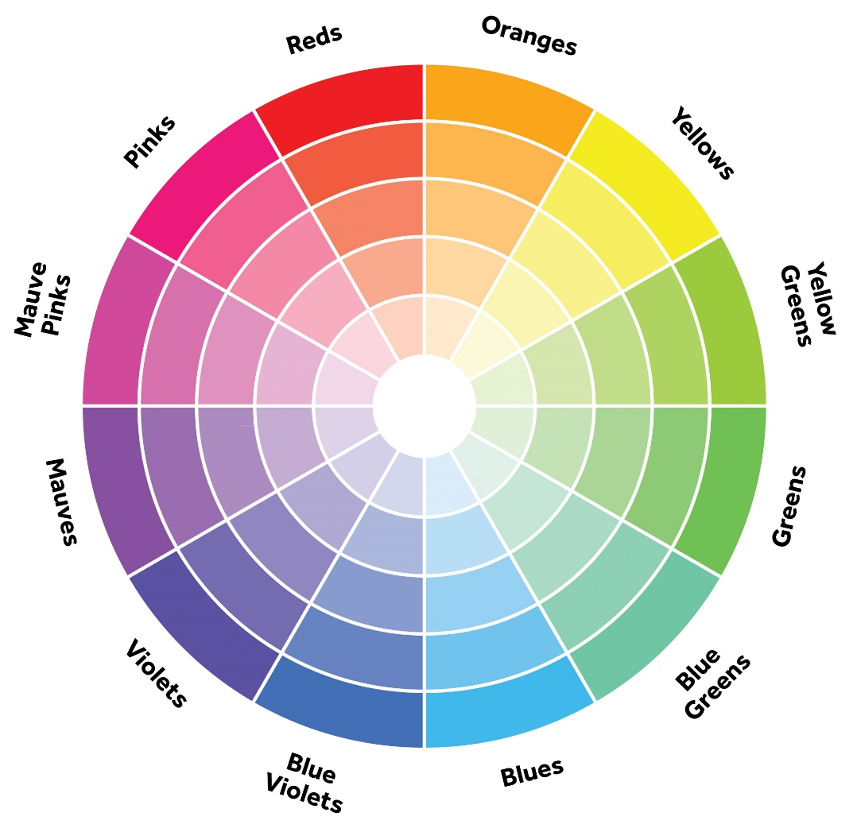
Color Palette
Choose 2-4 colors only
One color – light
One color – dark
One color – neutral
Images and other multimedia are not included
Use color theory
Background color must be contrast with the font color
Dark color – font; light color – BG

Slide 26
Animations and Transitions
Animations v. transitions
Transitions – motions done in-between slides
Animations – motions done by the objects in the slides (text, images, etc.)
Use only when necessary
Used to create a bigger impact with the message
Use simple transitions / animations only (fade, dissolve, etc.)
Use the same transitions / animations if possible

Slide 27
Graphic Design
Principles of Graphic Design
Trends in Graphic Design
Balance
Proximity
Alignment
Hierarchy
Contrast
Use of white space
Repetition and movement
Minimalism
Extreme maximalism
Trending colors
Muted tones
Iridescence
90s / retro futurism
Metaverse

Slide 28


Bad Examples of Graphic Design

Slide 29
Presentation Templates
Modern organizations tend to have their own presentation templates
No need to think about designing the presentation
Better for company branding
Prevent using the templates from the common presentation software (PowerPoint, Slides, etc.)
Websites for presentation templates:
Slidesgo
Canva

Slide 30
Editing Out
Evaluate the presentation
Remove anything that can be too much
It is better to remove than to add things in

Slide 31
Best Practices on Oral Presentations
Understand the audience | Create an outline of the presentation | Ensure that the presentation works | Do not rely on the presentation | Practice, practice, practice | Acknowledgement

Slide 32
Best Practices for Oral Presentation
Understand the audience
Create an outline of the presentation
Ensure that the presentation works
Do not rely on the presentation
Practice, practice, practice
Acknowledgement

Slide 33
Understand the Audience
Audience types to consider:
Outside the company v. inside the company
Management v. technical experts
Higher ranking v. same / lower ranking
Older age range v. younger age range
Content and presentation with the audience in mind
Length of the presentation
Specificity of the presentation
Terms to use
Design of the presentation

Slide 34
Outline of the Presentation
Create an outline based on the nature of the presentation and the audience
Add only relevant material
Focus on the important message
Think of the flow of the presentation
Have a clear beginning, middle, and end
Take note of the time and the presenters before and after you

Slide 35
Ensure that the Presentation Works
Review audio and/or video of the presentations
Take note of the size of the video
Take note of the volume of the audio
Multimedia should be relevant
Prevent from taking too much time for the multimedia
Cut the audio / video to just focus on the important parts
Know when the multimedia should start / end
Give context if possible

Slide 36
Do Not Rely on the Presentation
Presentations are meant to aid
Use visuals sparingly but effectively
Visuals should be relevant to the presentation
Include visuals only to aid the presentation
Presenters should not be reliant on presentations
Presenters can still talk about the topic even with technical difficulties
Prevent reading the presentation

Slide 37
Practice, Practice, Practice
Create keycards to help with the presentation
Use presenter view
Present to a friend or another co-worker

Slide 38
Acknowledgement
Give credit to those who helped during your presentation
Team members who are part of the project
Mentors / supervisors

Slide 39
References
https://smallbusiness.chron.com/oral-presentation-workplace-1710.html
https://courses.lumenlearning.com/publicspeakingprinciples/chapter/chapter-12-methods-of-delivery/

